Slide 1






Stateless Services Pattern
Load Balancer
Load Balancer
Scale stateless services backed by partitioned storage
Increase reliability and ordering with queues
Reduce read latency with caches
Manage your own transactions for state consistency
Front End
(Stateless
Web)
Stateless
Middle-tier
Compute
Cache
Queues Storage

Slide 2

Stateful Services Pattern Simplify design, reduce latency
Load Balancer
Application state resides in the compute tier
Low latency reads and writes
Partitions are first class at the service layer for scale-out
Built in transactions
External stores for exhaust and offline analytics
Front End
(Stateless
Web)
Stateful
Middle-tier
Compute
Cold Data Stores
(Optional)
Selling Point: stateful services are unique to Service Fabric

Slide 3
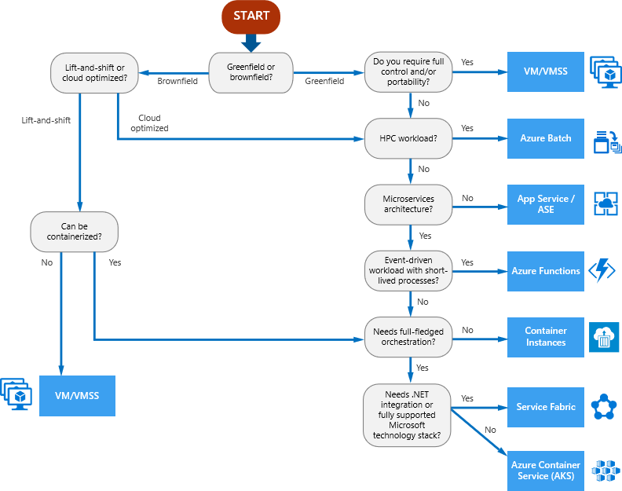
Compute Decision Tree
Compute Services covered:
VM
VMSS
Azure Batch
App Service
App Service Environment
Azure Functions
Container Instances
Service Fabric
Azure Kubernetes Service

Slide 4
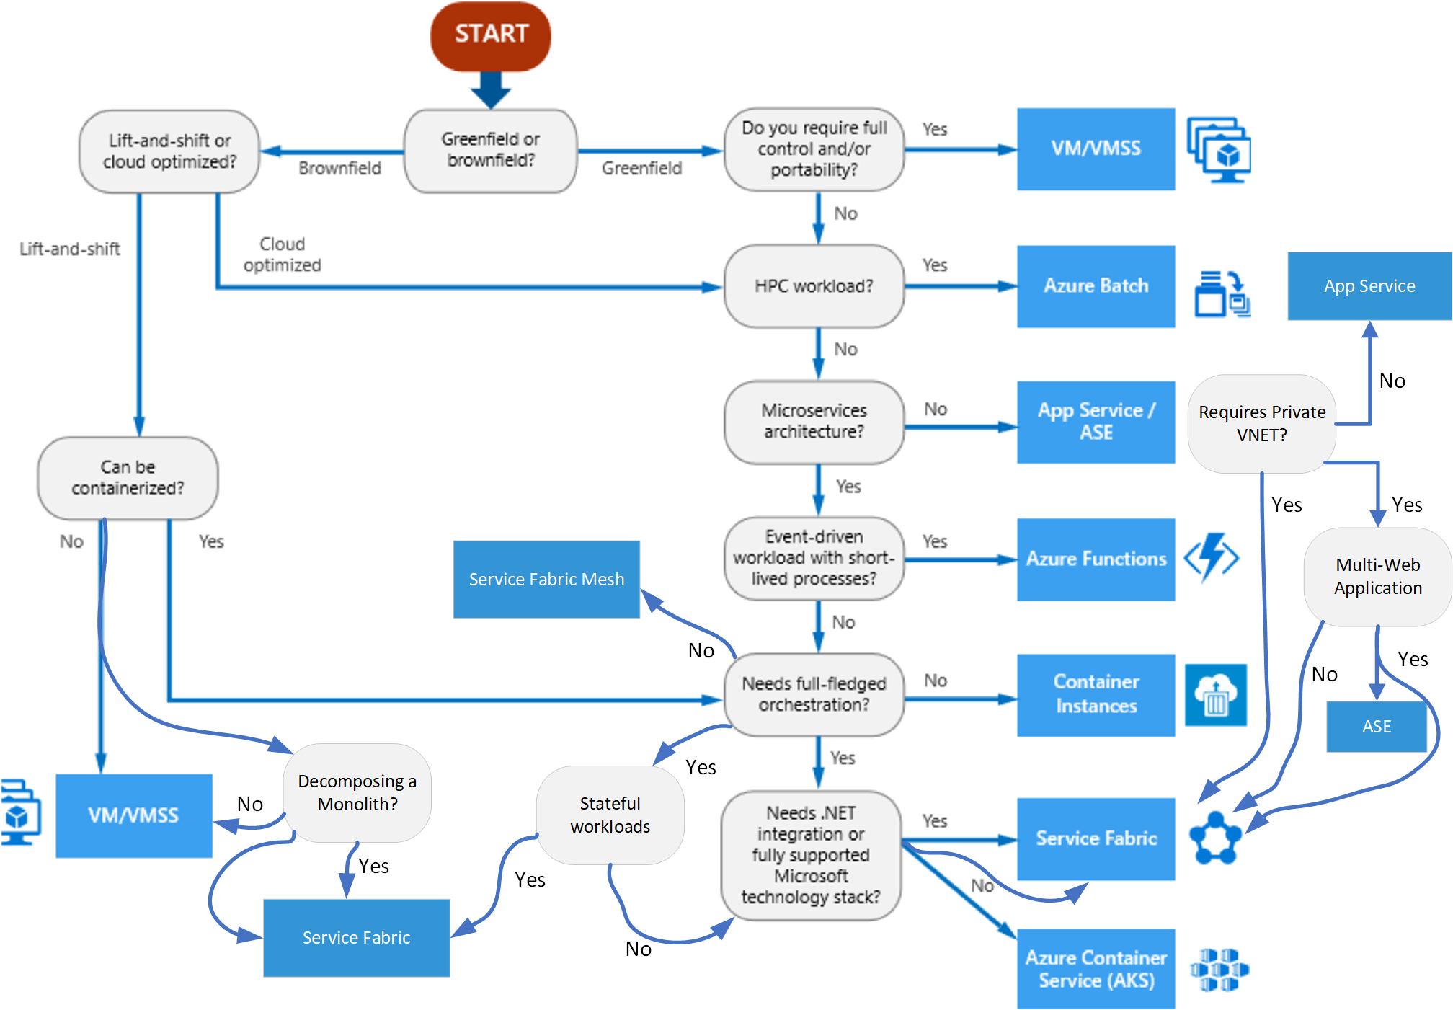
Compute Decision Tree v2

Slide 5
Cloud App Continuum
AI-based apps
Cloud Native
Microservices, Serverless
….
App Modernized
Lift&Shift to PaaS
Cloud Optimized
Lift&Shift to containers
May involve containers
Engineering Complexity and Cost
Lift and Shift
VMs
May involve containers
No code changes
Existing OnPrem Applications
App Modernization
Agility, Time to Market Total Cost of Ownership, IT Simplification

Slide 6


Service Fabric Host Infrastructure
VNET: 10.0.0.0/23
Example network infrastructure for an enterprise deployment
Service Fabric cluster
Application Subnet 10.0.0.0/24
Management Subnet 10.0.1.0/24
Application Node Type – externally exposed subnet
Primary Node Type – isolated internal subnet
Host IP 10.0.0.4
App Host 1
Container
Reverse Proxy: 443
Container A
10.0.0.5
Container C
10.0.0.6
Primary Host 1
Host IP 10.0.1.4
Host IP 10.0.0.7
Primary Host 2
App Host 2
Host IP 10.0.1.5
Container Reverse Proxy: 443
Container B
10.0.0.8
Primary Host 3
Host IP 10.0.1.6
Host IP 10.0.0.9
Primary Host 4
App Host 3
Host IP 10.0.1.7
Container A
10.0.0.10
Primary Host 5
Host IP 10.0.1.8

Slide 7
Infrastructure Best Practices
Use Multiple NodeTypes (VMSS cluster)
2 NodeTypes are ideal
One for Service Fabric Primary services
Two for the application containers
Use Placement Constraints to deploy to the apps NodeType
Ensure enough space on the primary NodeType temp disk
Use a VM compute size with 50 GB of temp disk or more (i.e. Standard_D2_v3)
Use the optimal VMSS Windows Image for each NodeType
i.e. Windows Server 2016 + Containers for apps NodeType
i.e. Windows Server 2016 (no containers) for primary NodeType
<Service Name="ArrSrv" ServicePackageActivationMode="ExclusiveProcess">
<StatelessService ServiceTypeName="ArrSrvType" InstanceCount="[ArrSrv_InstanceCount]">
<SingletonPartition />
<PlacementConstraints>(NodeTypeName==appNT)</PlacementConstraints>
</StatelessService>
</Service>
ApplicationManifest.xml

Slide 8
Infrastructure Best Practices cont.
Ensure container images get trimmed from OS disk
Applies only to App NodeType
{
"name": "Hosting",
"parameters": [
{
"name": "IPProviderEnabled",
"value": "true"
},
{
"name": "PruneContainerImages",
"value": "True"
},
{
"name": "ContainerServiceArguments",
"value": " "
},
]
},
ApplicationManifest.xml

Slide 9
Container Networking Diagram
Client invokes application running in Container A over HTTPS
VNET
Service Fabric cluster
Host IP 10.0.0.4
SF Host 1
ARR
Container
Reverse Proxy: 443
3
Container A
10.0.0.5
Container C
10.0.0.6
1
3
Host IP 10.0.0.7
SF Host 2
ARR
Container Reverse Proxy: 443
Container B
10.0.0.8
3
2
3
2
ARR Reverse Proxy – NAT bridge
Containers A/B/C – open networking
Host IP 10.0.0.9
SF Host 3
Container A
10.0.0.10
SF DNS
Service

Slide 10
Networking Best Practices
If apps need to share the same port (80/443)
Use Open Networking
IP-per-container
Deploy a custom reverse proxy to a container
ARR (Application Request Routing) for URL Rewrite
Needed for Open Networking scenario
Dockerfile available for this container
Leverage the Service Fabric DNS Service
Maps a well known service name to the dynamic IP running the container
<Service Name="app01svc" ServiceDnsName="app01.container.abcxdomain.com">
<StatelessService ServiceTypeName="app01svcType" InstanceCount="[app01svc_InstanceCount]">
</StatelessService>
</Service>
ApplicationManifest.xml

Slide 11
Scaling Best Practices
Use Resource Constraints to optimize container placement
Container Auto-scale
<Policies>
<ContainerHostPolicies CodePackageRef="Code" Isolation="default">
<RepositoryCredentials AccountName="acnsfc" Password="" PasswordEncrypted="false"/>
<NetworkConfig NetworkType="Open"/>
</ContainerHostPolicies>
<ServicePackageResourceGovernancePolicy CpuCores="1" MemoryInMB="1024" />
</Policies>
ApplicationManifest.xml
<Service Name="app01svc" ServiceDnsName="app01.container.abcxdomain.com">
<StatelessService ServiceTypeName="app01svcType" InstanceCount="[app01svc_InstanceCount]">
<ServiceScalingPolicies>
<ScalingPolicy>
<AveragePartitionLoadScalingTrigger MetricName="servicefabric:/_CpuCores" LowerLoadThreshold="0.2" UpperLoadThreshold="0.3" ScaleIntervalInSeconds="600"/>
<InstanceCountScalingMechanism MinInstanceCount="1" MaxInstanceCount="2" ScaleIncrement="1"/>
</ScalingPolicy>
</ServiceScalingPolicies>
</StatelessService>
</Service>
ApplicationManifest.xml

Slide 12
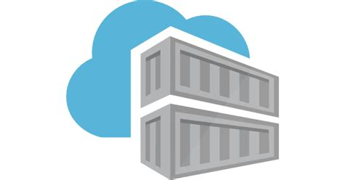

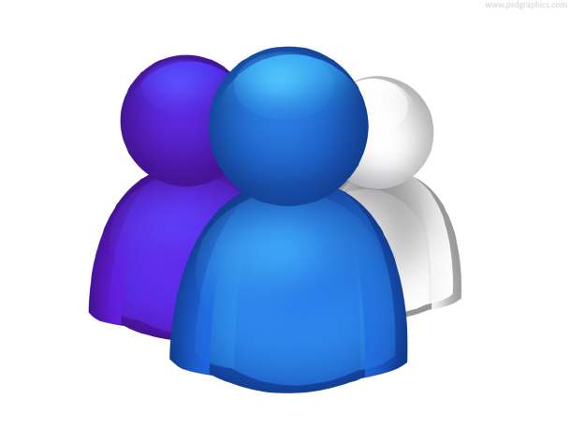





DevOps Lifecycle Example
App Container Registry
Image
Scanning
Security
Developers
Pull
Runtime Scan
Push
Deploy
VSTS
Build/Test
Service Fabric Environments
Monitor
(Log Analytics)
Push
Pull
Container Engineering
Base Image Container Registry
KEY:
Developer
Container Engineering
Security

Slide 13
Security Best Practices
If Windows Integrated Security required…
Use Group Managed Storage Accounts (MSI support coming)
Requires domain joined App NodeType hosts
If not, use Docker Environment Variables to pass secrets to containers
<Policies>
<ContainerHostPolicies CodePackageRef="Code" Isolation="default">
<SecurityOption Value="credentialspec=file://container_gmsa1.json"/>
<NetworkConfig NetworkType="Open"/>
</ContainerHostPolicies>
</Policies>
ApplicationManifest.xml
<CodePackage Name="Code" Version="1.0.0">
<EntryPoint>
<ContainerHost>
<ImageName>acnsfc.azurecr.io/app01:2.2</ImageName>
</ContainerHost>
</EntryPoint>
<EnvironmentVariables>
<EnvironmentVariable Name="databaseconnectionstring" Value="Server=10.0.0.56;Database=Test;User ID=testuser;Password=;Integrated Security=false;MultipleActiveResultSets=True;Connect Timeout=30"/>
<EnvironmentVariable Name="LOGANALYTICS_CONTAINERS_MASK_ENVVAR_VALUE_REGEX_LIST" Value="/database?/,/pass?/"/>
</EnvironmentVariables>
</CodePackage>
ServiceManifest.xml

Slide 14
Security Best Practices cont.
Leverage 3rd Party container image vulnerability scanning
Push/Pull into Azure Container Registry
Two vendors have marketplace products
Aqua Security, Twistlock
Optionally provision on-host container firewall with Aqua/Twistlock
Azure Security Center adding scanning and host firewall features
Linux container support in preview
Windows containers on roadmap
Read cluster template secrets from Key Vault
"VMSS-AdminPassword": {
"reference": {
"keyVault": {
"id": "/subscriptions/…/providers/Microsoft.KeyVault/vaults/vaultname"
},
"secretName": "VM-AdminPassword"
}
},
ARM-template-params.xml

Slide 15
Docker Health Check
Understand Service Fabric Health Monitoring
https://docs.microsoft.com/en-us/azure/service-fabric/service-fabric-health-introduction
Plug into health monitoring with Docker Health Checks
FROM enttest.azurecr.io/windowsservercoreweb:1.43
SHELL ["powershell", "-Command", "$ErrorActionPreference = 'Stop'; $ProgressPreference = 'SilentlyContinue';"]
RUN New-Item -ItemType Directory C:\inetpub\wwwroot\AppDir;
COPY ./healthcheck.bat C:\install
COPY ./install-website.ps1 C:\install
COPY ./wildcard.pfx C:\install
COPY ./PublishOutput /inetpub/wwwroot/AppDir
# The install-website will remove the Default site and create App website on inetpub\wwwroot, and install wildcard cert
RUN C:\install\install-website.ps1
HEALTHCHECK --interval=30s --timeout=30s --start-period=60s --retries=3 CMD C:\install\healthcheck.bat
App Dockerfile
C:\curl.exe --fail http://localhost || exit 1
Healthcheck.bat

Slide 16
Reusable Assets -- GitHub
https://github.com/colincole/ServiceFabricContainers
White Paper
Containerizing Enterprise Applications With Azure Service Fabric
Enterprise cluster ARM template
Multiple nodetypes, open networking monitoring, KeyVault integration, etc.
Reverse Proxy using ARR (Application Request Routing)
dockerfile and scripts

